Slide 1

Coursera Capstone Project
Avishek Dasgupta

Slide 2
Background & Business Problem
“Amaretto” is a global chain of Italian Restaurants, headquartered at New York, with multiple branches across USA. In the last 5 years, they have also forayed into the international market.
With the appointment of the new CEO, they have developed an aggressive expansion strategy and are looking to further extend their business across Europe, with Berlin being a key target as the upcoming European Headquarters.
Due to the strategic importance of Berlin, the location to be chosen for the restaurant is of vital importance.
There is already a stiff competition in the food & beverages industry and Berlin being the economic hotspot of entire Europe, boasts of a huge number of restaurants and pubs, including quite a few Italian Restaurants.
In this scenario, it is urgent to adopt machine learning tools in order to assist ‘Amaretto’ to make wise and effective decisions regarding the location of the Berlin Restaurant.

Slide 3
Data
Berlin is divided into 12 different Boroughs or neighbourhoods. The data regarding the different Boroughs with their population was extracted from Wikipedia. The following fields were extracted: Name of Borough, Population, Area in Sq. Km and Population Density per Sq. Km.
The Latitude-Longitude details for each borough was obtained by using Nominatim.
To explore and recommended locations across different boroughs according to the presence of other restaurants, data was obtained through FourSquare API interface and it was arranged as a dataframe for visualization.
The following fields were extracted from FourSquare API: Name of Venue, Venue Latitude, Venue Longitude and Venue Category.
By merging data on Berlin Boroughs and data of existing restaurants in a Borough from FourSquare API interface and further by using the k-Means Clustering method, recommended location options are provided for the new restaurant.

Slide 4
Methodology
The Methodology section will describe the main components of our analysis and the statistical testing performed on the dataset. The Methodology section has four sub-sections as described below:
Data Collection
After importing the necessary libraries, the data regarding the different Boroughs of Berlin with their population was extracted from Wikipedia. The following fields were extracted: Name of Borough, Population, Area in Sq. Km and Population Density per Sq. Km.
Data Inspection and exploration
We read the dataset that we collected from Wikipedia regarding Berlin Boroughs into a pandas' data frame and display the data. Our dataset consists of 12 rows and 5 columns. The data was now prepared and pre-processed for analysis.

Slide 5
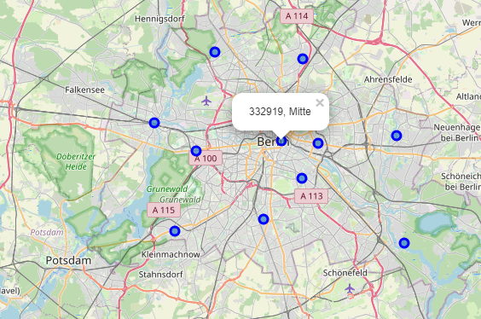
Methodology
Data preparation and pre-processing
Using the Nominatim function, the central location coordinates for each of the 12 Boroughs was extracted. We created a map of Berlin with the central coordinates of each Borough marked in same

Slide 6
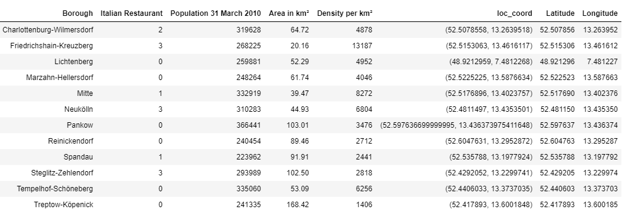
Methodology
Data preparation and pre-processing
Using FourSqaure API, the information regarding the nearby venues of each Borough is collected. The number of existing Italian Restaurants per Borough was analysed along with the population density of the particular area.

Slide 7
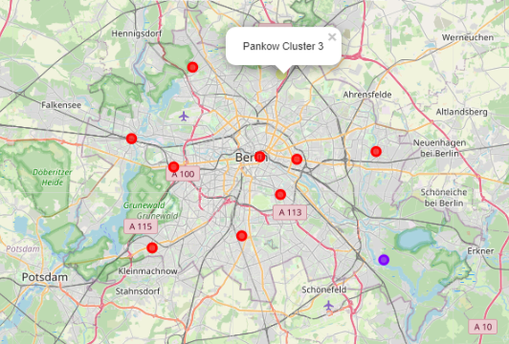
Methodology
Statistical Modelling
At this stage, we prepare our dataset for the modelling process and opted for the K-means clustering method to denote the Boroughs into Clusters. The K value was chosen as 4. Based on the 4 clusters, each cluster was analysed as per the type of most frequently visited venues:

Slide 8
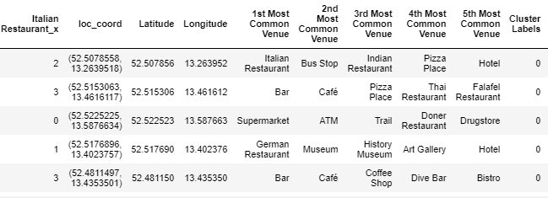
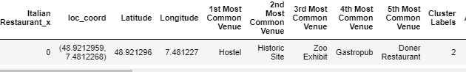
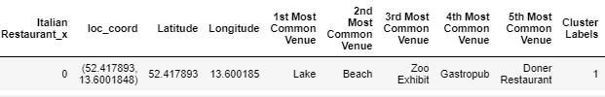
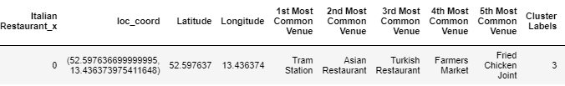
Methodology
Various Clusters
Cluster 0
Cluster 2
Cluster 3
Cluster 1

Slide 9
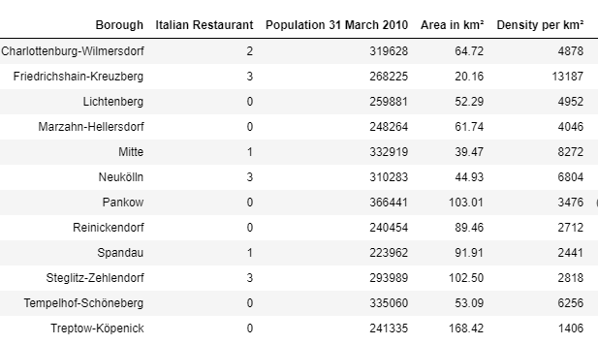
Results
In the first section of analysis, it was found that there are existing Italian restaurants in 6 of the 12 Boroughs: 3 each in Friedrichshain, Neukolin & Steglitz, 2 in Charlottenburg and 1 each in Mitte & Spandau

Slide 10
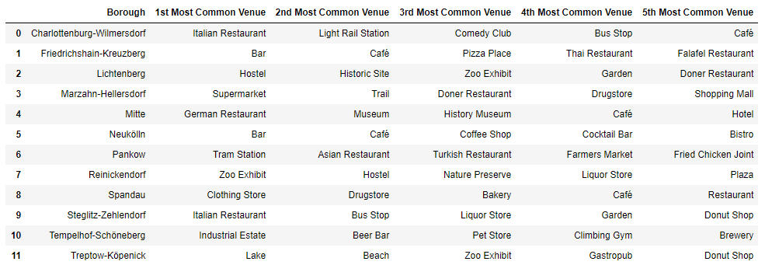
Results
Secondly, the most frequently visited places in each Borough are given below:

Slide 11
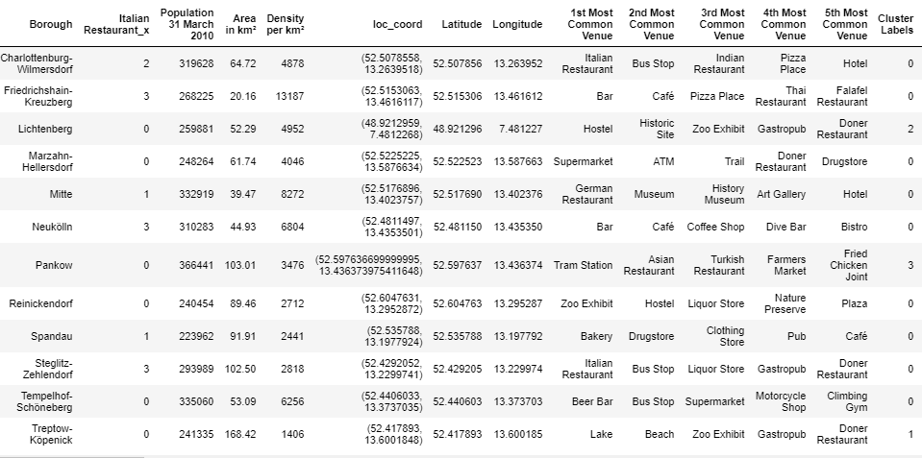
Results
Finally, after the K-means clustering analysis, it was found that Treptow , Lichtenburg, Pantow lie in Cluster 1, 2 & 3 respectively while rest of the Boroughs are in Cluster 0.

Slide 12
Discussion & Conclusion
The most visited places in Boroughs located in Cluster 1, 2 & 3 are historical or natural places, which signifies that the people living in these areas enjoy visiting to different places rather than eating out
However, in Cluster 0, the top 5 visited places usually contains restaurants, pubs, bars and other Food & Beverages Places, which means Boroughs belonging to Cluster 0 are more suitable for a new Italian Restaurant
Marzahn-Hellerdorf, Reinickendorf, Templehof-Schoneberg belong to Cluster 0, however they do not have any Italian restaurants in these Boroughs. Out of these 3 Boroughs, Templehof-Schoneberg has the highest population density and their most visited place is a beer bar. So it seems to be a good choice for the new venue.
On further analysis, it is noted that Borough Mitte has the second highest population density among the Boroughs, however has only one Italian Restaurant in the area. Further, it has a Central location and has historical monuments and hotels in the top 5 visited places, which ensures a large footfall of external people to the Borough along with their residential members. Further, the most visited place in the Borough is a restaurant.
Given the fact, that the Berlin branch is poised to become the European headquarters in near future, it is essential that it garners high visibility along with profitability. Therefore, Borough Mitte seems to be the perfect choice for opening this restaurant and is recommended as per the analysis performed.

